Slide 1
Introduction to Machine Learning
Hongjun (Jack) Wu
Chapter 1 – Lecture 3

Slide 2
Basically…
You first train the model, and then you predict whatever you want to get on a new set of data you just acquired.

Slide 3
Step 1.
Training

Slide 4
Training
Training data could be any data! (text, image, etc.)
Then you extract feature via a process called Feature Extraction.
Then you have a set of features and label for the feature.
Then you train a model using machine learning algorism.

Slide 5
What are features and labels?
Features
Feature is pretty much the data. For example, one set of data for a person could contain education status, years of experience, major in university, crime history, etc.
Labels
Then labels are what we are predicting. For example, salary for that person.

Slide 6
Example Data
 | Person A | Person B | Person C
Salary | 1000 | 2000 | 7000
Education Status | 3 | 4 | 5
Crime History | 1 | 0 | 0

Slide 7
Step 2.
Predict

Slide 8
Prediction Process
You get a new set a data (Information of another human)
Throw it into the model we trained
You predict his salary.

Slide 9
Here is a flow chart…
Train
Features
Algorism
Train Data
Feature Extraction
Label
Train
Predict
New Data
Feature Extraction
Features
Model
Predict
Prediction

Slide 10
END

Slide 11
Instructions for use
EDIT IN GOOGLE SLIDES
Click on the button under the presentation preview that says "Use as Google Slides Theme".
You will get a copy of this document on your Google Drive and will be able to edit, add or delete slides.
You have to be signed in to your Google account.
EDIT IN POWERPOINT®
Click on the button under the presentation preview that says "Download as PowerPoint template". You will get a .pptx file that you can edit in PowerPoint.
Remember to download and install the fonts used in this presentation (you’ll find the links to the font files needed in the Presentation design slide)
More info on how to use this template at www.slidescarnival.com/help-use-presentation-template
This template is free to use under Creative Commons Attribution license. You can keep the Credits slide or mention SlidesCarnival and other resources used in a slide footer.

Slide 12
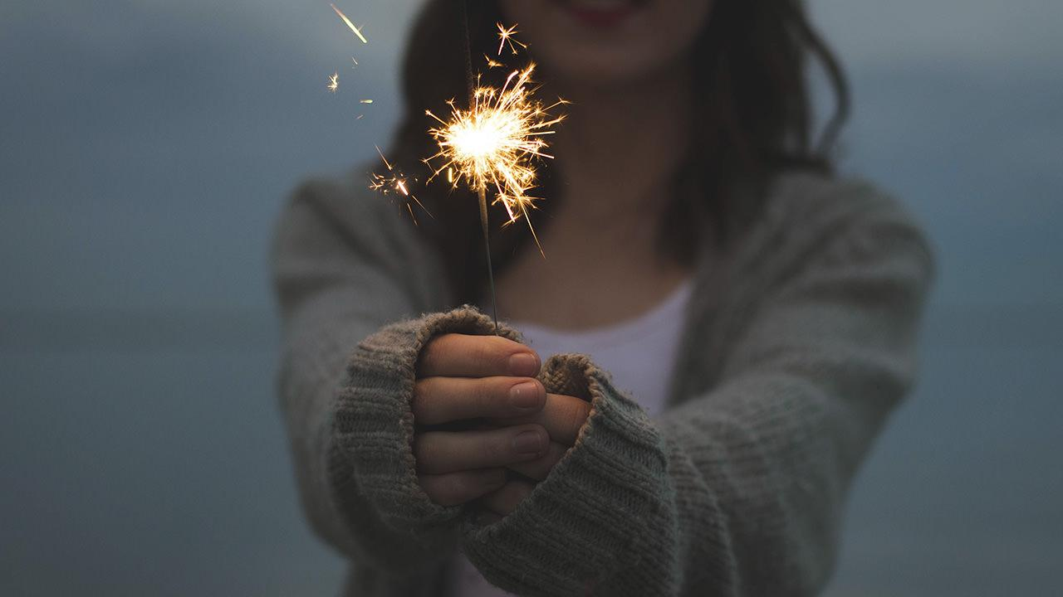
Hello!
I am Jayden Smith
I am here because I love to give presentations.
You can find me at @username

Slide 13
“Quotations are commonly printed as a means of inspiration and to invoke philosophical thoughts from the reader”

Slide 14
You can also split your content
White
Is the color of milk and fresh snow, the color produced by the combination of all the colors of the visible spectrum.
Black
Is the color of coal, ebony, and of outer space. It is the darkest color, the result of the absence of or complete absorption of light.

Slide 15
In two or three columns
Yellow
Is the color of gold, butter and ripe lemons. In the spectrum of visible light, yellow is found between green and orange.
Blue
Is the colour of the clear sky and the deep sea. It is located between violet and green on the optical spectrum.
Red
Is the color of blood, and because of this it has historically been associated with sacrifice, danger and courage.

Slide 16
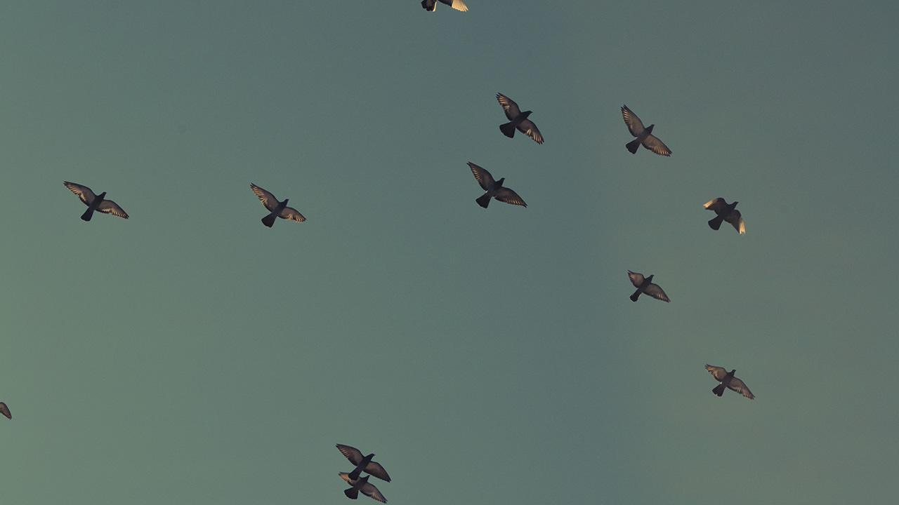
A picture is worth a thousand words
A complex idea can be conveyed with just a single still image, namely making it possible to absorb large amounts of data quickly.

Slide 17
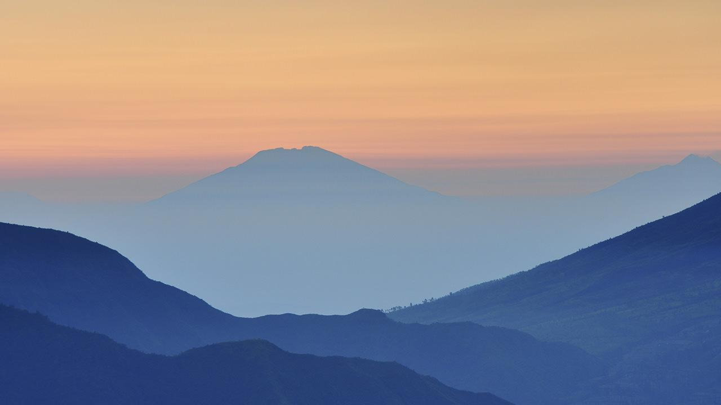
Want big impact?
Use big image.

Slide 18
Use charts to explain your ideas
White
Gray
Black

Slide 19
Our process is easy
first
second
last

Slide 20
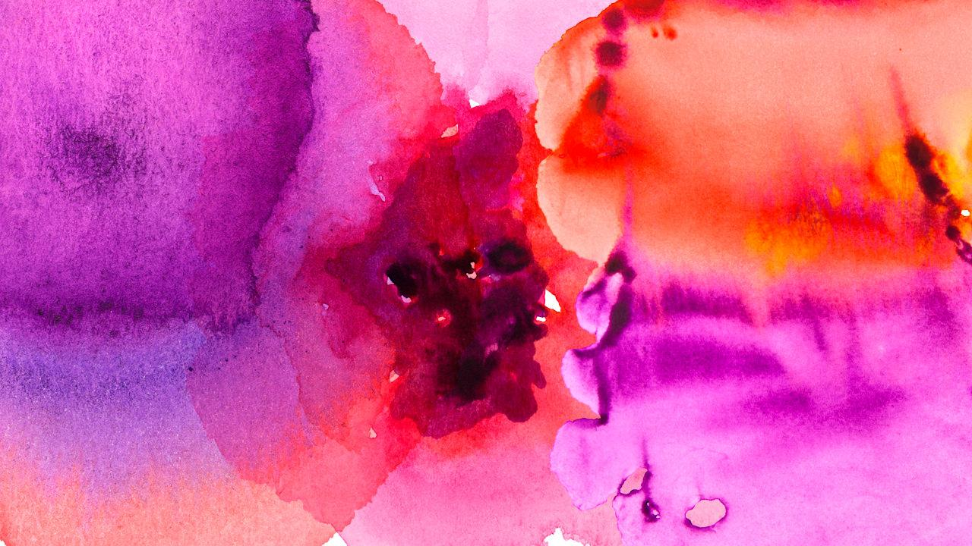
And tables to compare data
 | A | B | C
Yellow | 10 | 20 | 7
Blue | 30 | 15 | 10
Orange | 5 | 24 | 16

Slide 21
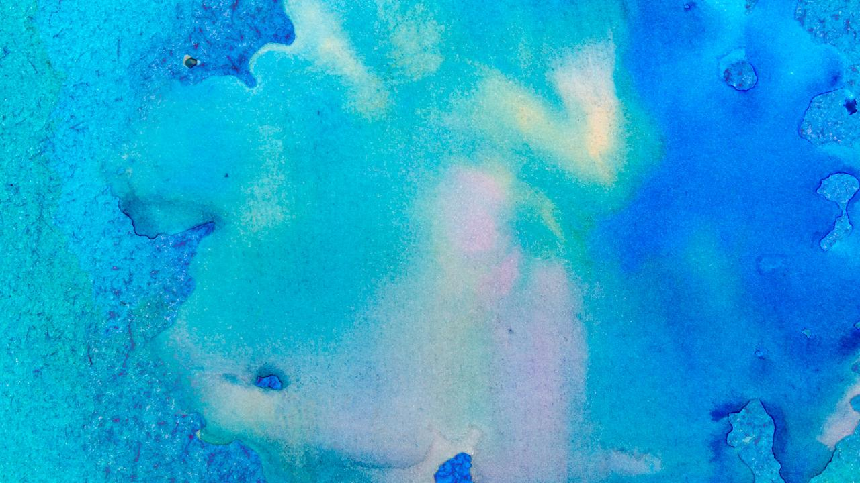
Maps
our office

Slide 22
89,526,124
Whoa! That’s a big number, aren’t you proud?

Slide 23
89,526,124$
185,244 users
100%
That’s a lot of money
And a lot of users
Total success!

Slide 24
Let’s review some concepts
Yellow
Is the color of gold, butter and ripe lemons. In the spectrum of visible light, yellow is found between green and orange.
Blue
Is the colour of the clear sky and the deep sea. It is located between violet and green on the optical spectrum.
Red
Is the color of blood, and because of this it has historically been associated with sacrifice, danger and courage.
Yellow
Is the color of gold, butter and ripe lemons. In the spectrum of visible light, yellow is found between green and orange.
Blue
Is the colour of the clear sky and the deep sea. It is located between violet and green on the optical spectrum.
Red
Is the color of blood, and because of this it has historically been associated with sacrifice, danger and courage.

Slide 25
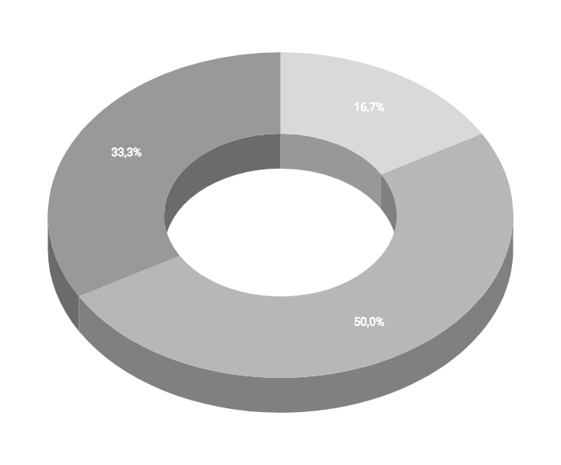
You can insert graphs from Google Sheets

Slide 26
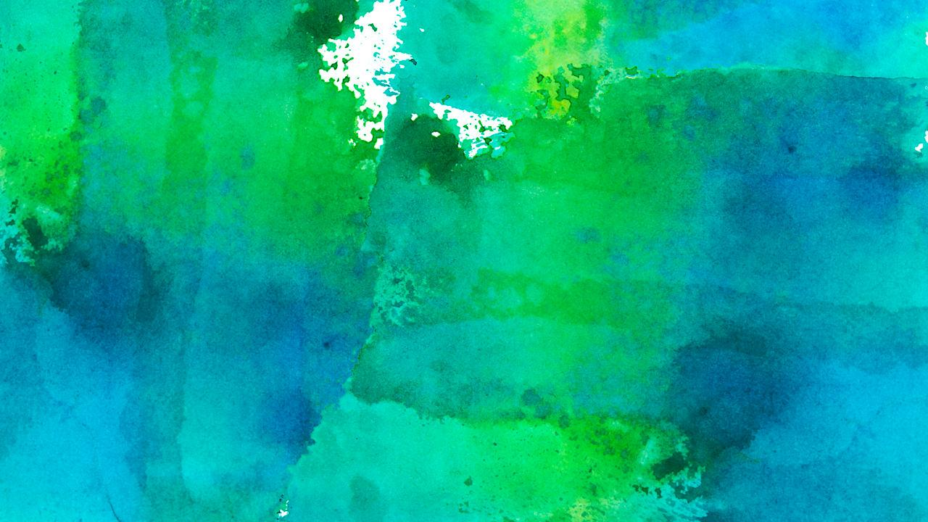
Android project
Show and explain your web, app or software projects using these gadget templates.
Place your screenshot here

Slide 27
iPhone project
Show and explain your web, app or software projects using these gadget templates.
Place your screenshot here

Slide 28
Tablet project
Show and explain your web, app or software projects using these gadget templates.
Place your screenshot here

Slide 29
Desktop project
Show and explain your web, app or software projects using these gadget templates.
Place your screenshot here

Slide 30
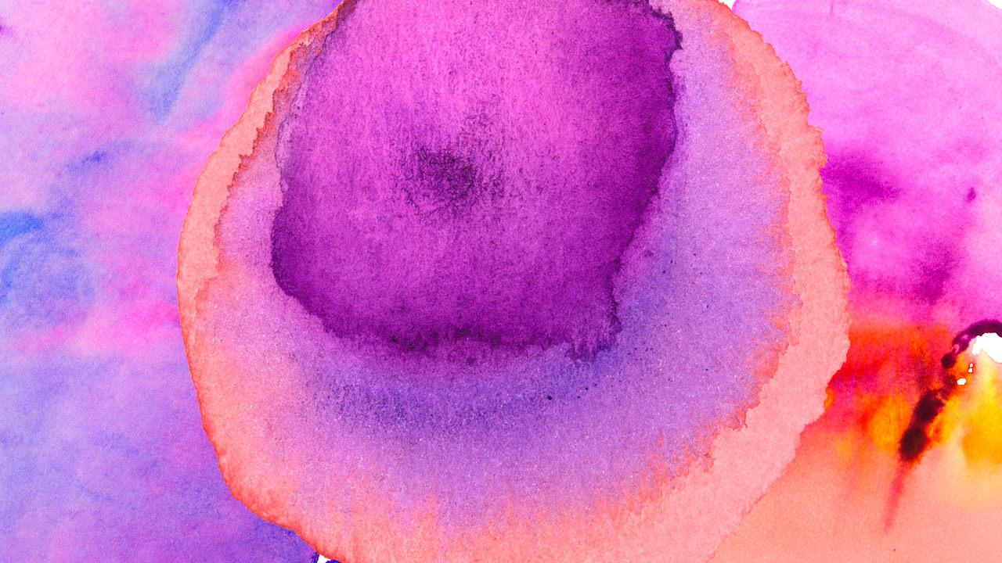
Thanks!
Any questions?
You can find me at:
@username
user@mail.me

Slide 31
Credits
Special thanks to all the people who made and released these awesome resources for free:
Presentation template by SlidesCarnival
Photographs by Unsplash
Watercolor textures by GraphicBurguer

Slide 32
Presentation design
This presentation uses the following typographies and colors:
Titles: Lato Thin
Body copy: Lato Light
You can download the fonts on this page:
http://www.latofonts.com/lato-free-fonts/
You don’t need to keep this slide in your presentation. It’s only here to serve you as a design guide if you need to create new slides or download the fonts to edit the presentation in PowerPoint®

Slide 33
SlidesCarnival icons are editable shapes.
This means that you can:
Resize them without losing quality.
Change fill color and opacity.
Isn’t that nice? :)
Examples:

Slide 34
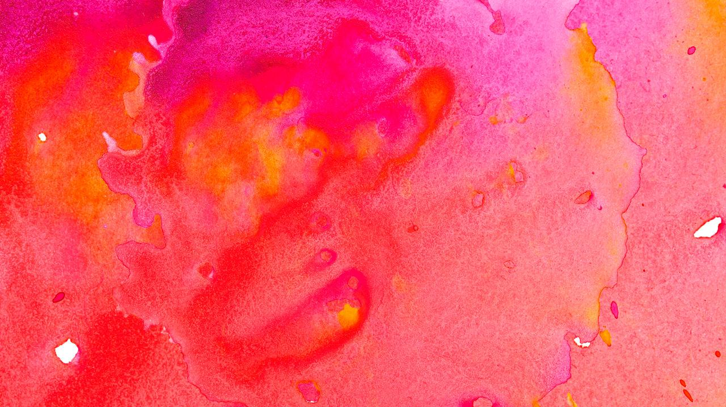
😉
Now you can use any emoji as an icon!
And of course it resizes without losing quality and you can change the color.
How? Follow Google instructions https://twitter.com/googledocs/status/730087240156643328
✋👆👉👍👤👦👧👨👩👪💃🏃💑❤😂😉😋😒😭👶😸🐟🍒🍔💣📌📖🔨🎃🎈🎨🏈🏰🌏🔌🔑 and many more...

